Slide 1

Clock Synchronization

Slide 2
Synchronization Concentrate on how process can synchronize
Synchronization is the capability to control the access of multiple threads to any shared resource.
Synchronization is better option where we want to allow only one thread to access the shared resource.
process can agree on the ordering of event or access the shared resources
For example, if multiple threads try to write within a same file then they may corrupt the data because one of the threads can override data or while one thread is opening the same file at the same time another thread might be closing the same file.

Slide 3
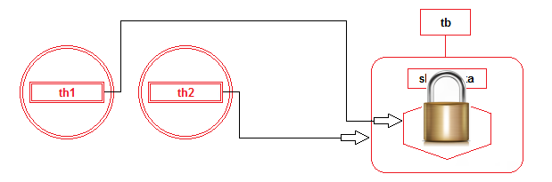
Synchronization is built around an internal entity known as the monitor or lock. Each object in java is associated with a monitor which a thread can lock or unlock. Only one thread at a time may hold a lock on a monitor.

Slide 4
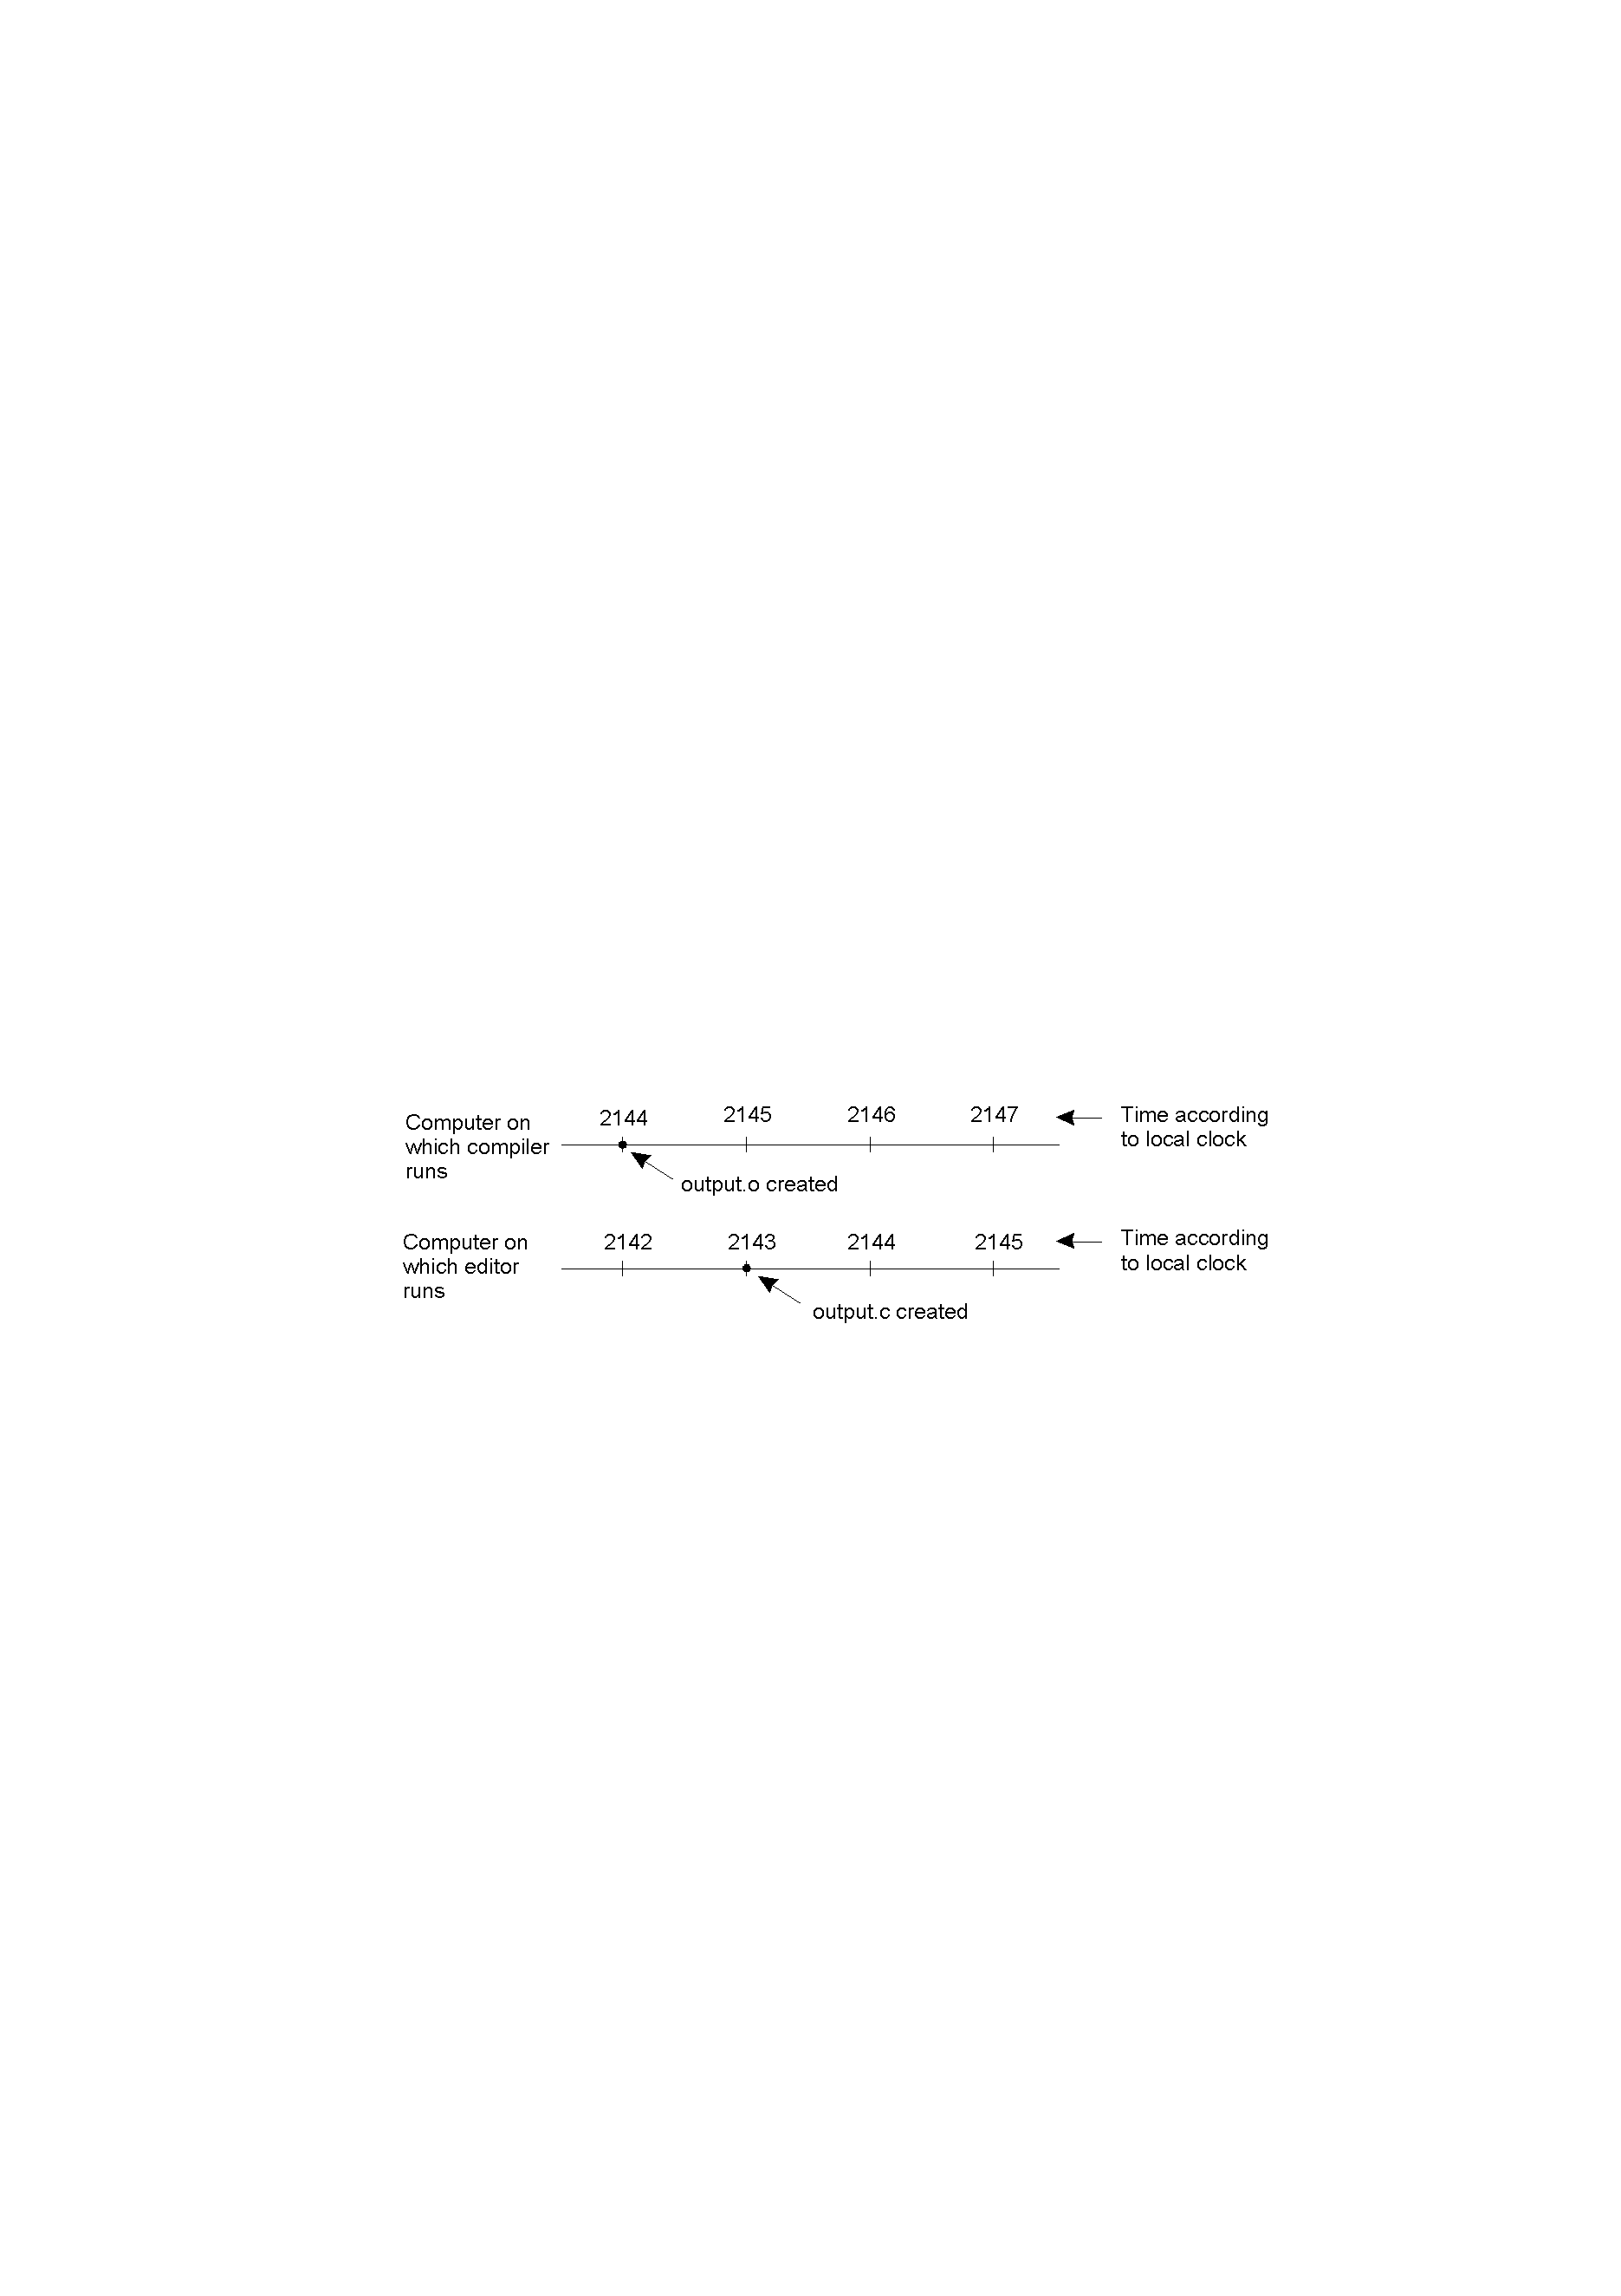
Clock Synchronization
When each machine has its own clock, an event that occurred after another event may nevertheless be assigned an earlier time.
The difference in time between two clocks due to drifting is defined as clock skew. As long as any and every two clocks differ by a value less than the maximum skew value, the time service is considered to be maintaining synchronization.
When each machine has its own clock, an event that occurred after another event may nevertheless be assigned an earlier time on another remote device. In the above, MAKE will not call the compiler for the newer version of the output.c program, even though it is “newer”.

Slide 5
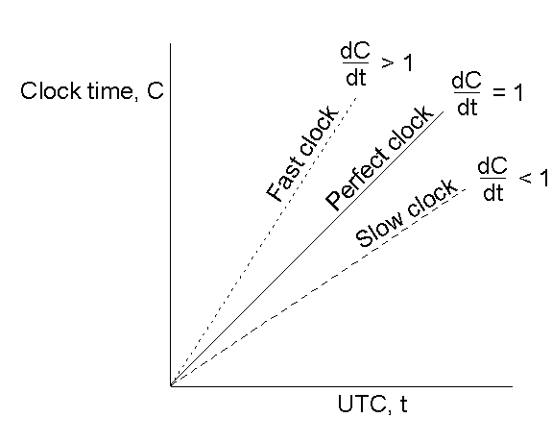

Clock Synchronization Algorithms
Computer timers go off H times/sec, and increment the count of ticks (interrupts) since an agreed upon time in the past.
This clock value is C.
Using UTC time, the value of clock on machine p is C_{p}(t).
For a perfect time, C_{p}(t) = t and dc/dt = 1.
For an ideal timer, H =60, should generate 216,000 ticks per hour.
Algorithms for clock synchronization useful for concurrency control based on timestamp ordering authenticity of requests e.g. in Kerberos (in late lecture)There is no global clock in a distributed system Logical time is an alternative It gives ordering of events - also useful for consistency of replicated data

Slide 6
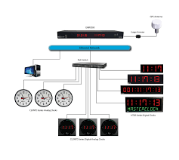
Sources of Accurate Timing Signals
International Atomic Time is based on very accurate physical clocks (drift rate 10-13).Coordinated Universal Time (UTC) is an international standard for time keeping . It is broadcast from radio stations on land and satellite (e.g. GPS).Computers with receivers can synchronize their clocks with these timing signal. Signals from land-based stations are accurate to about millisecond .Signals from GPS are accurate to about 1 microsecond

Slide 7
Clock Synchronization Algorithms
Centralized Clock Synchronization
Each node periodically sends a request message ‘time=?’ to the time-server to get accurate time. Time-server responds with ‘time=t’. Assume that client node send a message at time t0 and get a reply at time t1, then message propagation time from server to client node is (t1-t0)/2.
Client node receives a reply and it adjusts its clock time to t + (t1-t0)/2. For a more accurate time, there is need to calculate accurate message propagation time. There are two methods proposed to improve estimated time value.
This method uses time-server connected to a device that receives a signal from a source of UTC to synchronize nodes externally.

Slide 8
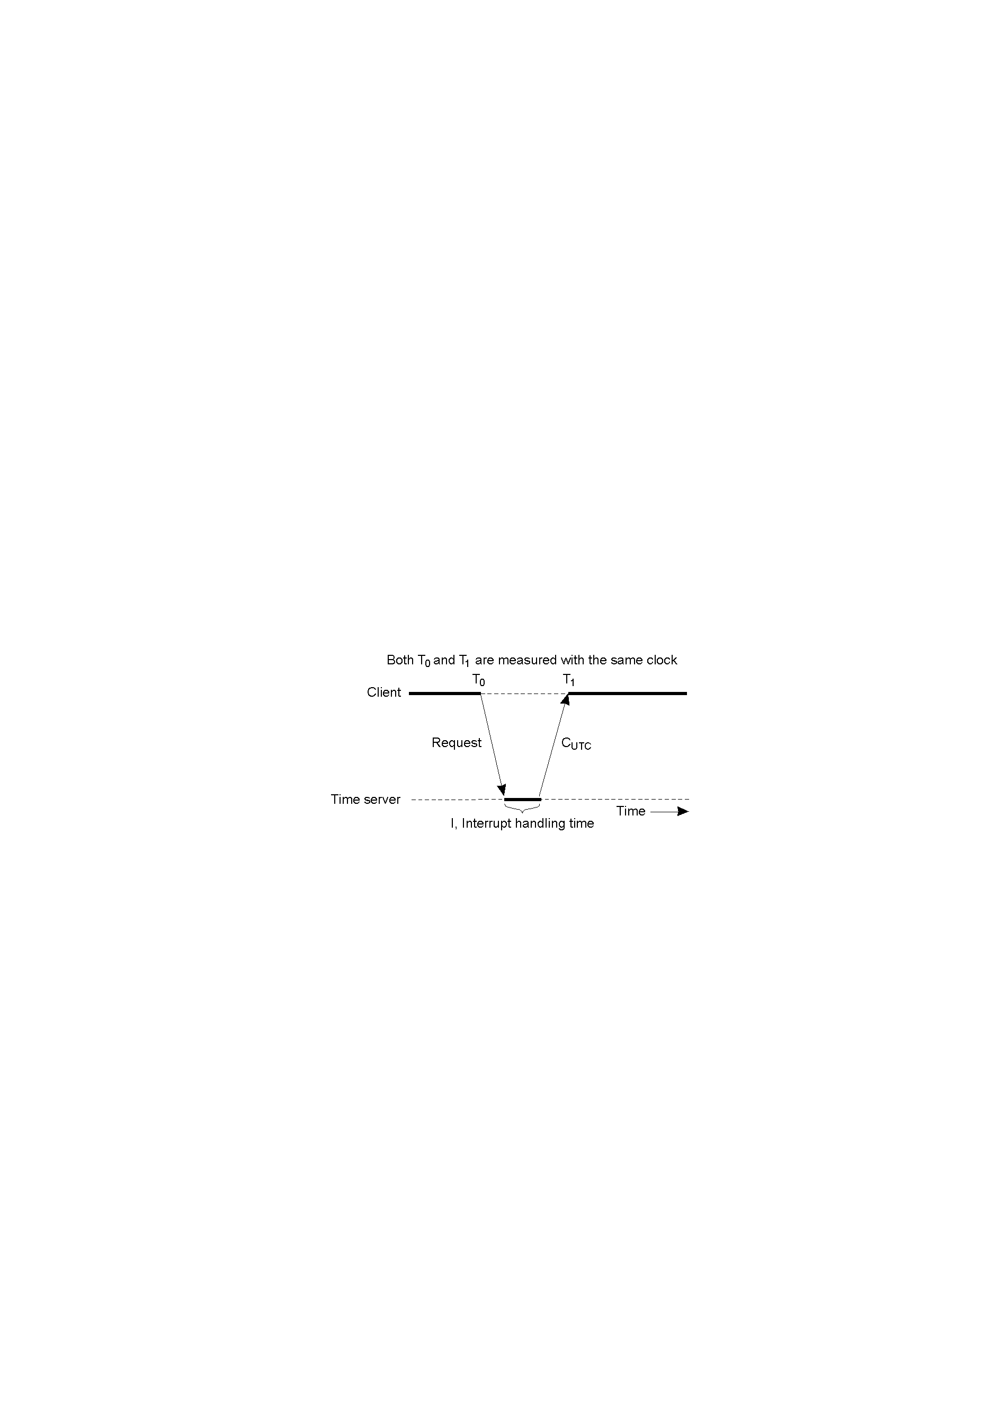
Getting the current time from a “time server”, using periodic client requests.
Major problem if time from time server is less than the client – resulting in time running backwards on the client! (Which cannot happen – time does not go backwards).
Minor problem results from the delay introduced by the network request/response: latency.

Slide 9
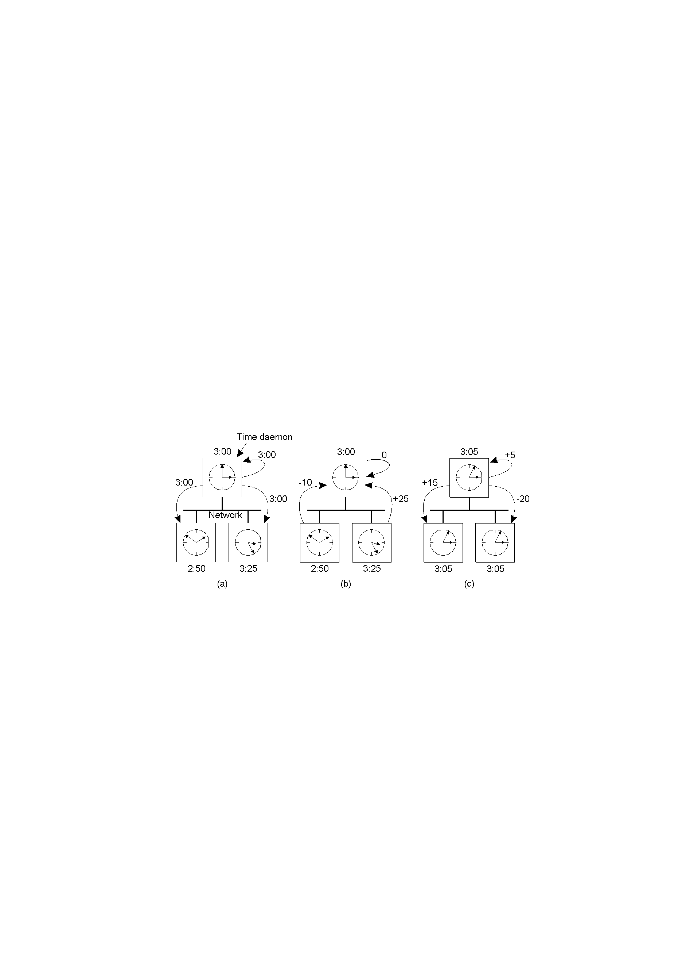
The Berkeley Algorithm
The time daemon asks all the other machines for their clock values.
The machines answer and the time daemon computes the average.
The time daemon tells everyone how to adjust their clock.

Slide 10
For a certain class of algorithms, it is the internal consistency of the clocks that matters. The convention in these algorithms is to speak of logical clocks.
Lamppost showed clock synchronization need not be absolute. What is important is that all processes agree on the order in which events occur.
Lamppost defined a relation ”happens before”. a → b ‘a happens before b’.
Happens before is observable in two situations:
If a and b are events in the same process, and a occurs before b, then a → b is true.
If a is the event of a message being sent by one process, and b is the event of the message being received by another process, then a → b is also true.

Slide 11
Distributed Algorithms
There is no centralized or reference time-server. It performs clock synchronization based on internal clock values of each node with the consideration of minimum clock skew value among clocks of different nodes in the system.
Distributed clock synchronization algorithm overcomes issue of scalability and single point of failure as there is no common or global clock required. Processes make decisions based on local information and relevant information distributed across machines [3]

Slide 12
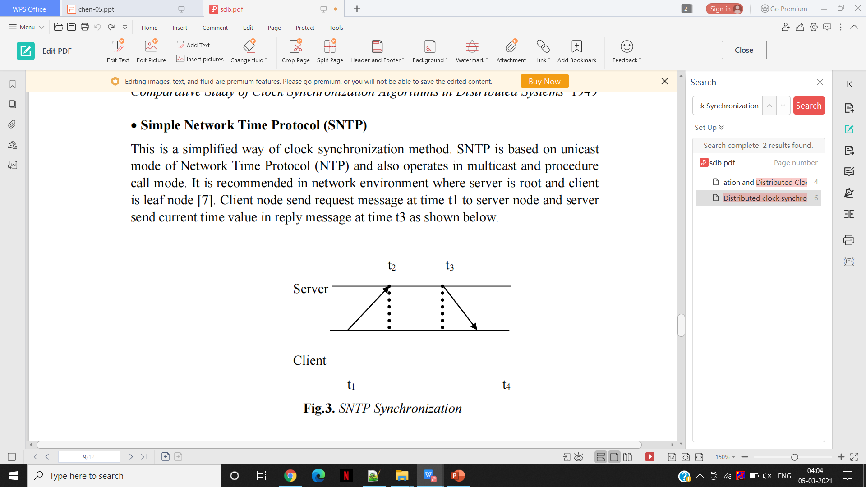
Simple Network Time Protocol (SNTP)
This is a simplified way of clock synchronization method. SNTP is based on unicast mode of Network Time Protocol (NTP) and also operates in multicast and procedure call mode.
It is recommended in network environment where server is root and client is leaf node [7]. Client node send request message at time t1 to server node and server send current time value in reply message at time t3 as shown below.

Slide 13
CONCLUSION
Clock synchronization is necessary for the ordering of events and to preserve the state of resources.
As per algorithms, we can say that for clock synchronization there is need to consider propagation time of messages among each node in both types of algorithms centralized and distributed.
Centralized synchronization algorithm suffers from the issues like scalability and network traffic. These issues can be overcome by distributed synchronization algorithms, but it also suffers from the issue of fault tolerance. Therefore, it is required to find a method that can give accurate average skew to find accurate local clock time.

Slide 14
Thank You

